Slide 1

Department of Computer Science & Engineering
Machine learning (Airbnb Price Prediction)
Name: Yash Kumar Gupta 201500820
Vijay Kaushal 201500783

Slide 2
Airbnb, as in “Air Bed and Breakfast,” is a service that lets property owners rent out their spaces to travelers looking for a place to stay. Travelers can rent a space for multiple people to share, a shared space with private rooms, or the entire property for themselves.

Slide 3
AGENDA
Conclusion
Modelling
Data Analysis
Data Cleaning
Data Set
Introduction

Slide 4
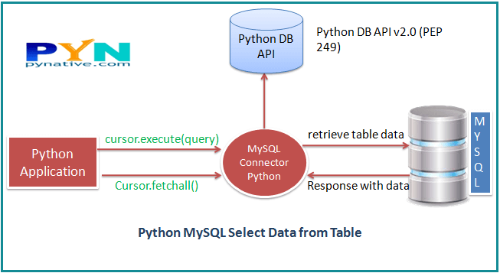
DataSets
Kaggle
Using web services
Using Python Library
Example :-using sklearn Library
import sklearn.datasets

Slide 5
Data Preprocessing
Have to collect the datasets and import it into the idle using read_csv() and for different formats of data we used different methods.
Show the given dataset using head().
Add the column or entity name as according to your feasibility.
Compress the dataset as much as you want to take it in use you can compress it.

Slide 6
Data Cleaning
Based on the dataset we have to do this task like:-
Dataset have Null Value
If of the data entity is different
Deal with inaccurate data
The datasets were prepared and cleaned with pandas, Numpy and missing no packages on python.

Slide 7
Data Visualization
Visualization is used to understand the objective and what the data relationship exist between the data entity
Visualization is used to do analysis between the dataset like Univariate Analysis and bivariate Analysis.
We used different plots and graph to visualize the data like:- Bar plot, Scatter Plot , line plot, bubble and pie many more plots.
We used matplotlib and seaborn library for data visualization.

Slide 8
Image Annotation
Image Annotation is one of the most important tasks in computer vision. With numerous applications, computer vision essentially strives to give a machine eyes.
For this task we using CVAT tools through which we classifies the data into various different classes.
This process is useful for data when we have to apply any deep learning algorithm in the given dataset like;- CNN, ANN.
We have to classify the data set in different outcomes classes as according to the prediction.

Slide 9
Machine Learning
In the past 30 years there has been an explosion of data. This mass of data is useless unless we analyze it and find the patterns hidden within.
Machine Learning techniques are used to automatically find the valuable underlying patterns within complex data that we would otherwise struggle to discover.
The hidden patterns and knowledge about a problem can be used to predict future events and perform all kinds of complex decision making.
As the quantity of data increases the accuracy also increases.

Slide 10
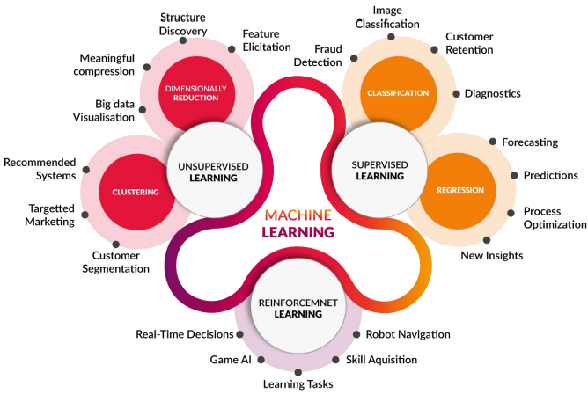
Machine Learning

Slide 11
Project
Topic:- Airbnb Price Prediction

Slide 12
Idea/Approach Details
The problem statement is to predict the price of Airbnb house based on multiple factors like locality, reviews per month, availability, room type etc ..
We implement different machine learning algorithms like ridge , lasso, decision tree etc. to predict the price.
We created a flask web app which takes input as neighbourhood group, room type availability and show predicted result on screen.
We performed exploratory data analysis to analyse (univariate and bivariate) the data set and summarize the data

Slide 13
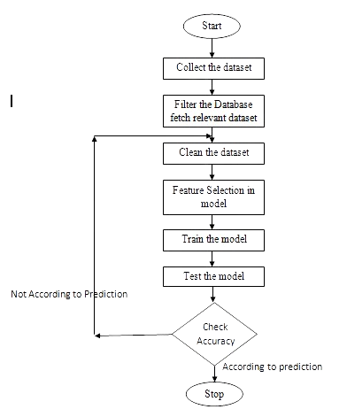
Flow of Project

Slide 14
Requirements
Describe your Technology stack here:
Python , Flask
Numpy, Pandas , Matplotlib, Sklearn, Pickle
Algorithms – Linear Regression , Ridge regression , lasso regression , Decision Tree

Slide 15
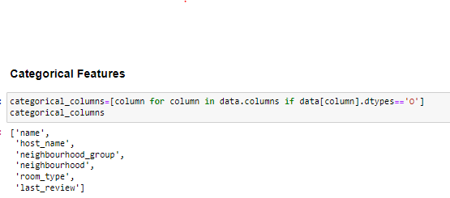
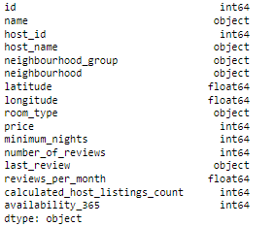
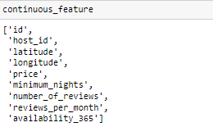
Dataset Details
Categorical and Continuous Features
Attributes types

Slide 16
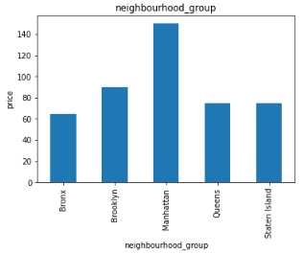
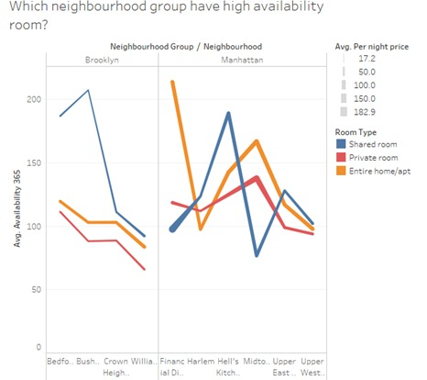
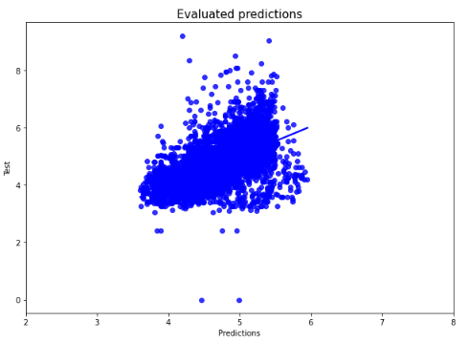
Analysis Details
Bi-variate Analysis
Analysis between Neighborhood and Availability

Slide 17
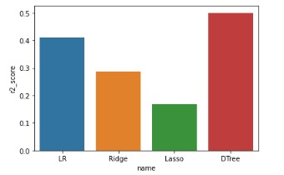
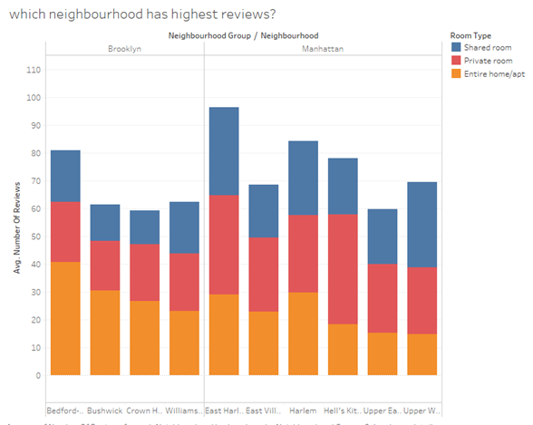
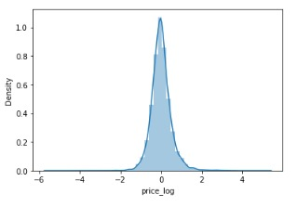
Machine Learning Algorithms
Machine Learning Algorithms Analysis
Analysis between Neighborhood and Availability

Slide 18
Analysis Details
Scope Of the Project
Analysis between Neighborhood and Availability
With the help of this project, Airbnb Home providers can find an equilibrium price that optimizes the profit and affordability.
Also, Guests can find the affordable and desired Airbnb with less prices. They can also plan their journey according to their budget and season. It also increases the employment for the people who have extra space and provide a better and affordable place for guest who are looking for housing options.
Avg. Price of Airbnb house in manhatten is 31% which is maximum among all the neighborhood group. Bronex is the cheapest as its contribution in pi chart is 14%.
Most of the persons prefers entire Room/ Apartment and very less people prefers shared Room to stay.
Average price of Entire Room/Apartment is 160 which is twice of the price of Private Room.

Slide 19
!! THANK YOU !!

